Slide 1



Slide 2
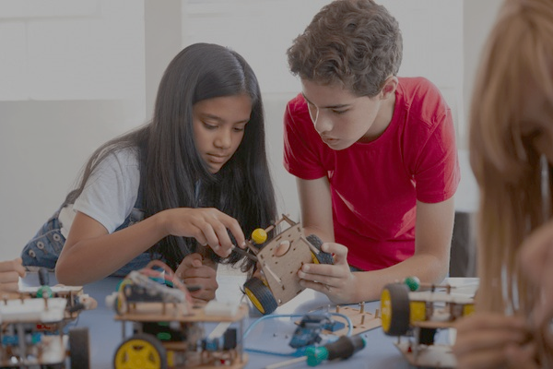
YOUR ONE STOP DESTINATION FOR AI & ROBOTICS

Slide 3
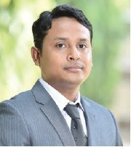
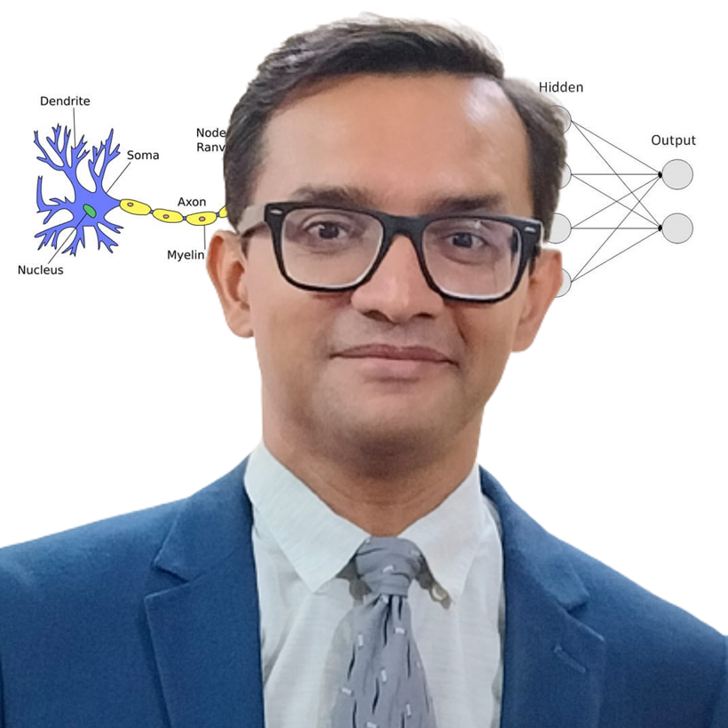
Our Speakers
Bappaditya Debsingha, IoT Product Manager, TCS, 18 years of global experience in Robotics
Anirban Chakrabarty, C.E.O. of Anodiam, 24 years of experience in IT, Corporate grooming & AI

Slide 4
You will learn from us
Problem solving skills
Creative thinking
Maths
Coding
Fundamentals of AI
Hands on Robotics

Slide 5
Abhishek

Slide 6
Abhishek

Slide 7
Bappa

Slide 8
Bappa

Slide 9
HYPE
REALITY

Slide 10

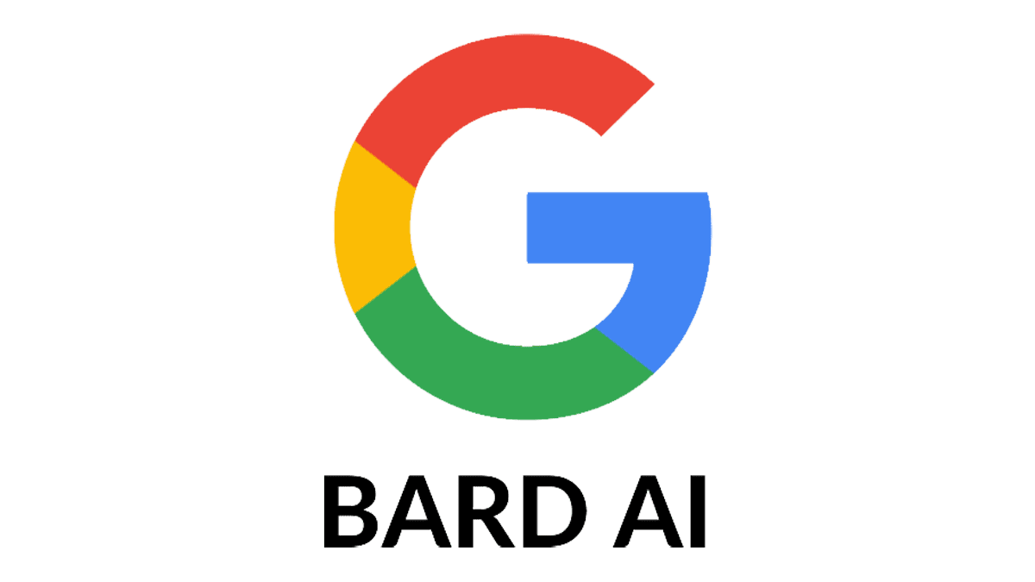



UNVEIL AI WITH US
Machine Learning
Creativity
Neural Networks
Mathematics
Deep Learning
Statistics
Coding
Data Science

Slide 11








AI PROFESSIONALS ARE SOUGHT AFTER ALL OVER THE WORLD

Slide 12
Effective Communication

